Slide 1

Power-Efficient FinFET Based Sense Amplifier
Sayooj S - 2310040095
Sameer - 2310040004
Venkat - 2310040076

Slide 2
Introduction to FinFET Sense Amplifiers
Challenges in SRAM Design
Advantages of FinFET Technology
As electronic devices shrink and supply voltages reduce, designing energy-efficient SRAM sense amplifiers becomes complex. Sense amplifiers must accurately detect small voltage differences on bitlines while minimizing power consumption.
FinFETs offer superior gate control, reduced leakage, and better noise margins compared to planar CMOS. These features make FinFETs ideal for low-power, high-performance memory circuits.

Slide 3
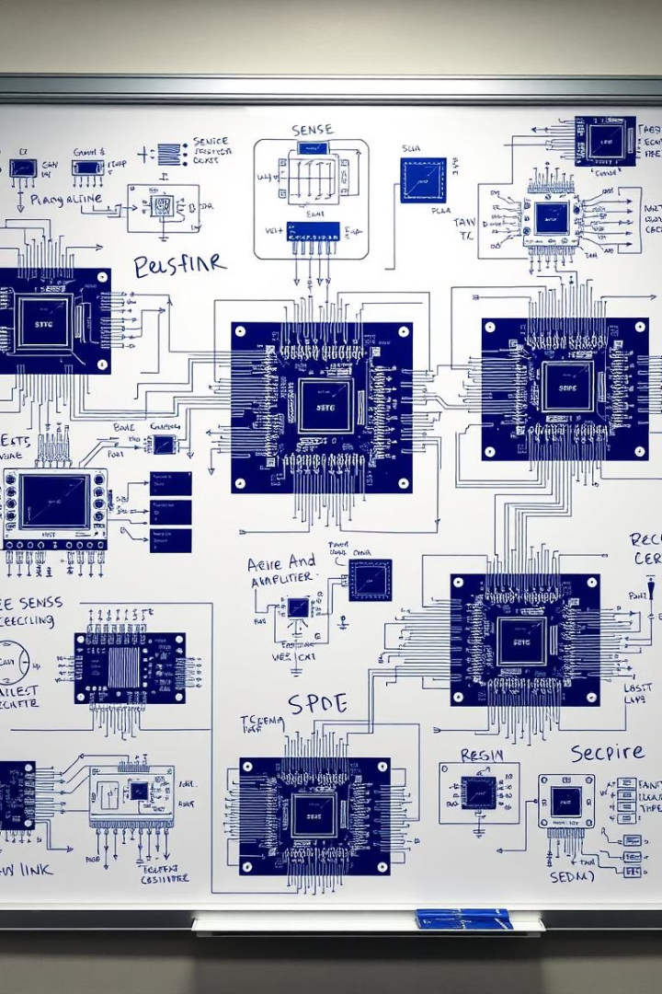
Literature Review: Sense Amplifier Architectures
Differential Voltage Sense Amplifiers
Current-Mode Sense Amplifiers
Known for noise rejection and speed, but face power challenges at scaled nodes.
Enable low-voltage operation but sensitive to current variations affecting accuracy.
Single-Ended Sense Amplifiers
Simple design but limited in noise immunity and speed performance.

Slide 4
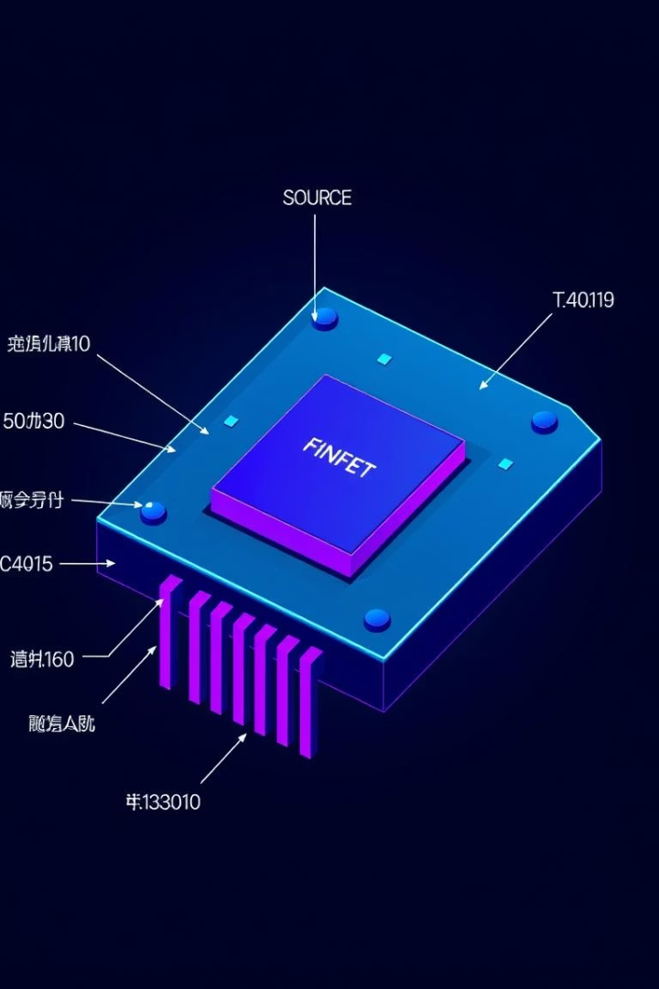
FinFET Device Physics for Low-Power Design
Multi-Gate Electrostatics
Multiple gates improve channel control, reducing short-channel effects and leakage.
Subthreshold Leakage Suppression
FinFETs significantly reduce off-state current compared to planar MOSFETs.
Fin Geometry Impact
Height, width, and number of fins influence power and performance trade-offs.
Process Variability
Variations in fin width and gate work function affect circuit robustness.

Slide 5
Power-Efficient Techniques in Sense Amplifiers
Conditional Pre-charging
Dynamic Biasing & Power Gating
Input Offset Cancellation
Activates pre-charge only when needed, reducing unnecessary switching power.
Reduces transistor mismatch effects, improving sensing accuracy and power efficiency.
Adjusts bias voltage/current and cuts power to inactive blocks to minimize leakage.

Slide 6
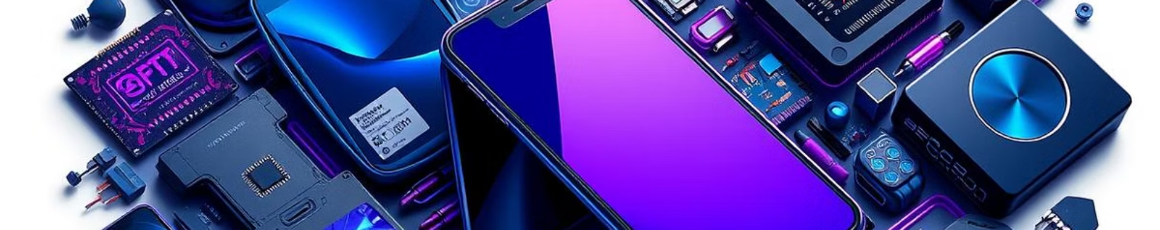




Applications of Power-Efficient SRAM
Mobile & Wearable Devices
Internet of Things (IoT)
Embedded Systems
Neuromorphic Computing
Supports ultra-low-power operation for long-lasting sensor nodes and edge computing.
Optimizes power budgets in automotive and industrial control microcontrollers.
Enables energy-efficient on-chip memory for AI synaptic weight storage.
Extended battery life and reduced thermal needs enable advanced functionalities.

Slide 7
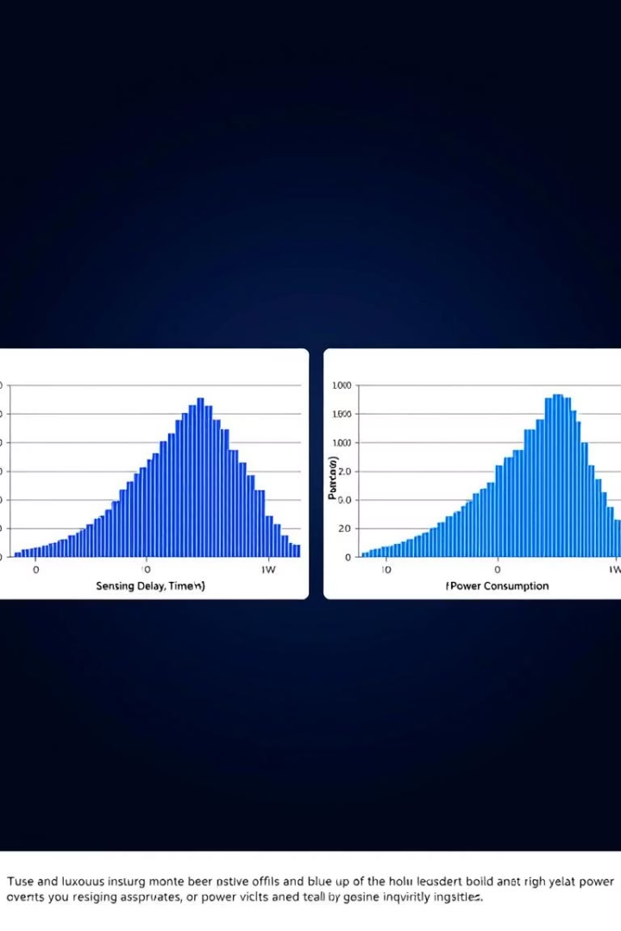
Robustness and Process Variation Analysis
Monte Carlo simulations with 500 runs indicate a standard deviation of 10 ps in sensing delay and 1 nW in static power, demonstrating good robustness against manufacturing variations. The FinFET design maintains reliable operation under typical process fluctuations, ensuring manufacturability and consistent performance.

Slide 8



Conclusion and Future Scope
Conclusion
The FinFET-based sense amplifier achieves significant power savings with acceptable speed and noise margins, validating its suitability for low-voltage SRAM applications.
Future Directions
Explore advanced FinFET architectures like gate-all-around nanowires.
Investigate adaptive body biasing for dynamic power control.
Integrate with novel low-power SRAM bitcells for system-level optimization.
Fabricate test chips for experimental validation.
Develop power-aware CAD tools for FinFET memory design.
Examine asynchronous sensing and security implications.

